Slide 2
The ONERep Dapp is to track the reputation badges for the developers working in a DAO ( The project team). Most of the DAO members use a Dapp called cordinape.com to track their tasks and pay the team members for their work. Cordinape lets the Project Admin export a csv with all the details of Project Member Name, wallet, received credits, sent credits, date etc
Our Dapp ONERep lets the project leads import that csv, mint NTTs (Non Transferable Tokens) and assign those tokens to the Project member wallets and help the Project Lead / Admin to keep track of the performance or reputation of each of the project member.

Slide 3
The main functions of ONERep Dapp
Manage reputation tokens per DAO
Register DAOs with DAO Name and NTT Badge Name
Add Contributor to DAO ONERep Account ( Remember DO NOT Confuse the ONERep Account contributor with the team member wallet coming in the csv, they are not related)
Import CSV
Mint NTTs, token count based on the sum value of the RECEIVED column in the csv (2 options, either mint tokens for the badge name given or mint dynamic tokens for the badge name)
Transfer the minted tokens to the individual wallet ids in the csv to the amount in RECEIVED column against their wallets.
Display the Team member name , wallet id, reputation tokens received in ONERep board ( sorted by token count descending by default, keep sort option on the grid header)
List the imported CSV files in ONERep Files menu with
CSV File Name
IPFS URI (Files to be uploaded to IPFS only after successful minting and transfer)
Mint Status
Transfer Status
Import Timestamp
Imported by (Wallet ID- Name)

Slide 4
2 Types of User Roles for the Dapp and functions
Super Admin
First time login with pre registered wallet (there is no registration process for Super Admin)
Add contributors ( contributors for this user role is same as super admin)
Make contributors as admin , enable disable contributors
Super admin should be able to see all csv files from all DAO Accounts in ONERep Files Menu
Super Admin should be able to see all team member reputation tokens from all DAOs in ONERep Board menu
Both ONERep Files and Board menu to have Select DAO Name from drop down (Default : All)
Super Admin DO NOT have CSV upload and Mint function
Dapp Account User
Dapp Account user will have data permission access to only the single DAO registered using his wallet or the wallet added as a contributor to a DAO account
Register DAOs with DAO Name and NTT Badge Name
Add Contributor to DAO ONERep Account ( Remember DO NOT Confuse the ONERep Account contributor with the team member wallet coming in the csv, they are not related)
Import CSV
Mint NTTs, token count based on the sum value of the RECEIVED column in the csv (2 options, either mint tokens for the badge name given or mint dynamic tokens for the badge name)
Transfer the minted tokens to the individual wallet ids in the csv to the amount in RECEIVED column against their wallets.
Display the Team member name , wallet id, reputation tokens received in ONERep board ( sorted by token count descending by default, keep sort option on the grid header)
List the imported CSV files in ONERep Files menu with
CSV File Name
IPFS URI (Files to be uploaded to IPFS only after successful minting and transfer)
Mint Status
Transfer Status
Import Timestamp
Imported by (Wallet ID- Name)

Slide 5
What happens when a contributor wallet is disabled?
That wallet will not be able to access that particular DAO Account and its functions.
That wallet when try to login again will be treated as a new DAO registration process taking to the registration page. Display a message saying “Your access to <DAO Name> is removed, Would you like to create a new DAO?” If yes, take to register page, NO then Landing Page.
The same logic applies for contributor accounts in both Super Admin and Dapp Account User roles.

Slide 6
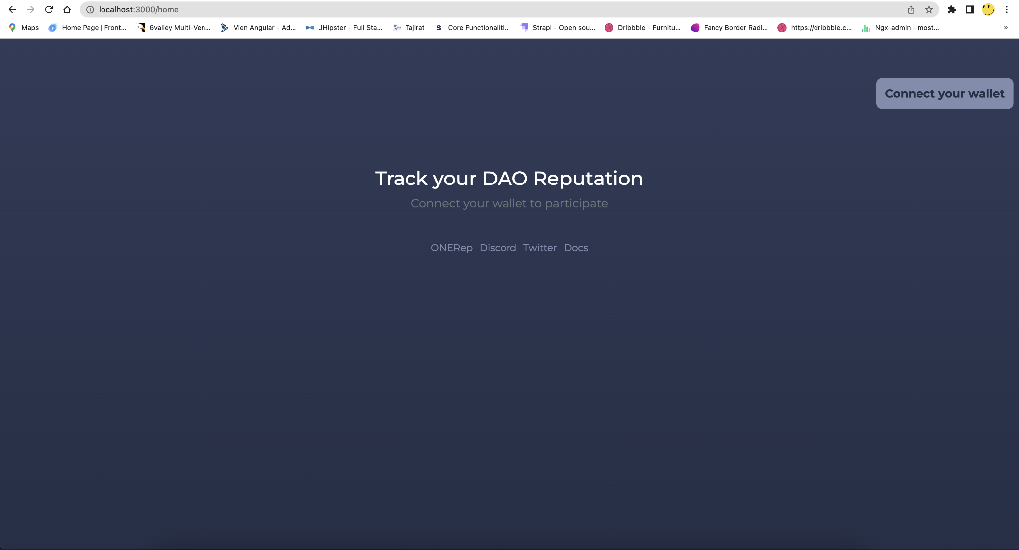
Home Page

Slide 7
Dapp user

Slide 8
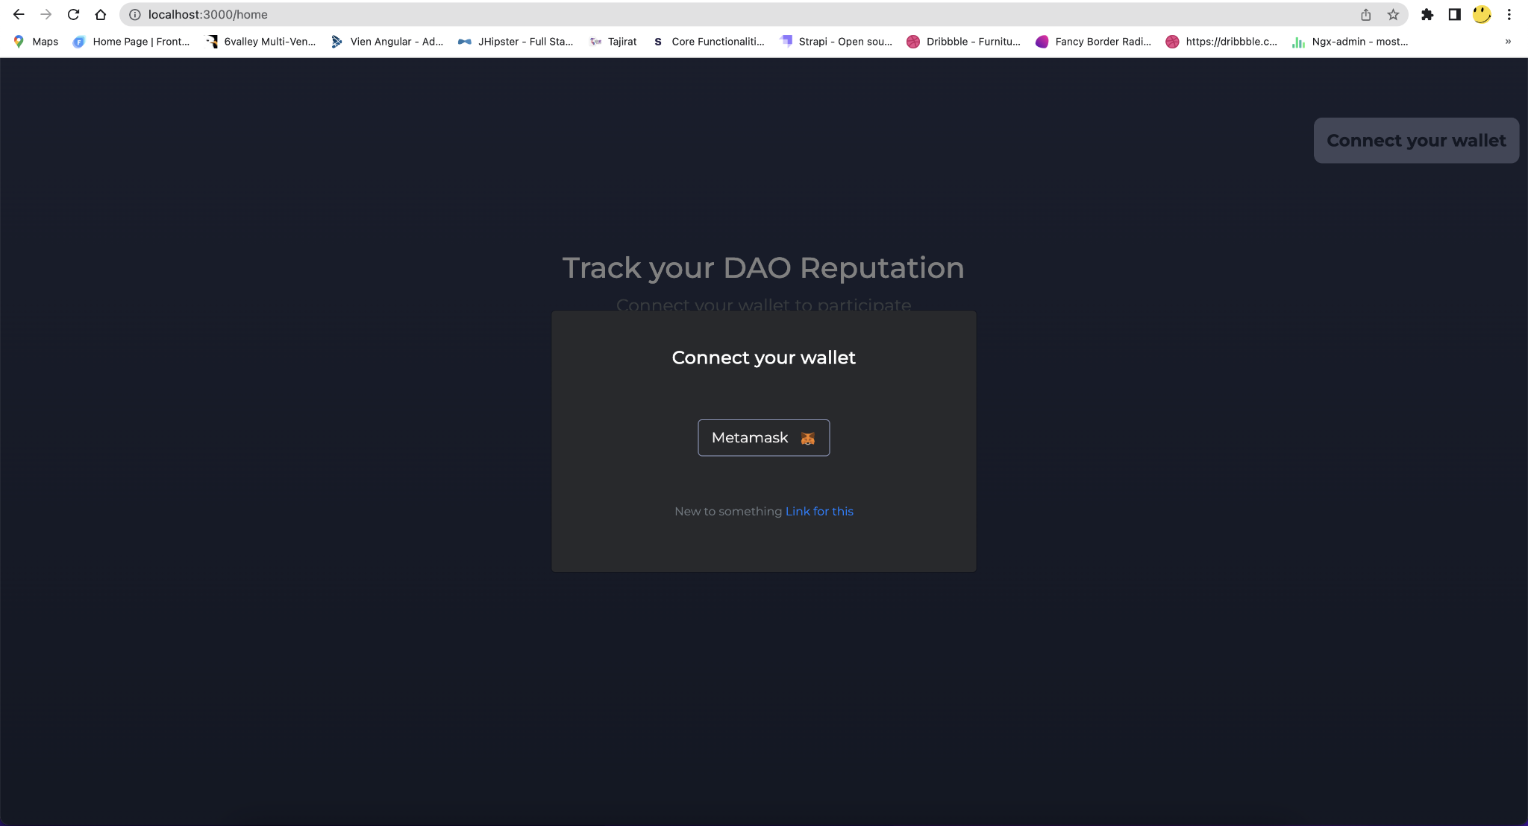
Dapp User - Wallet Connect

Slide 9
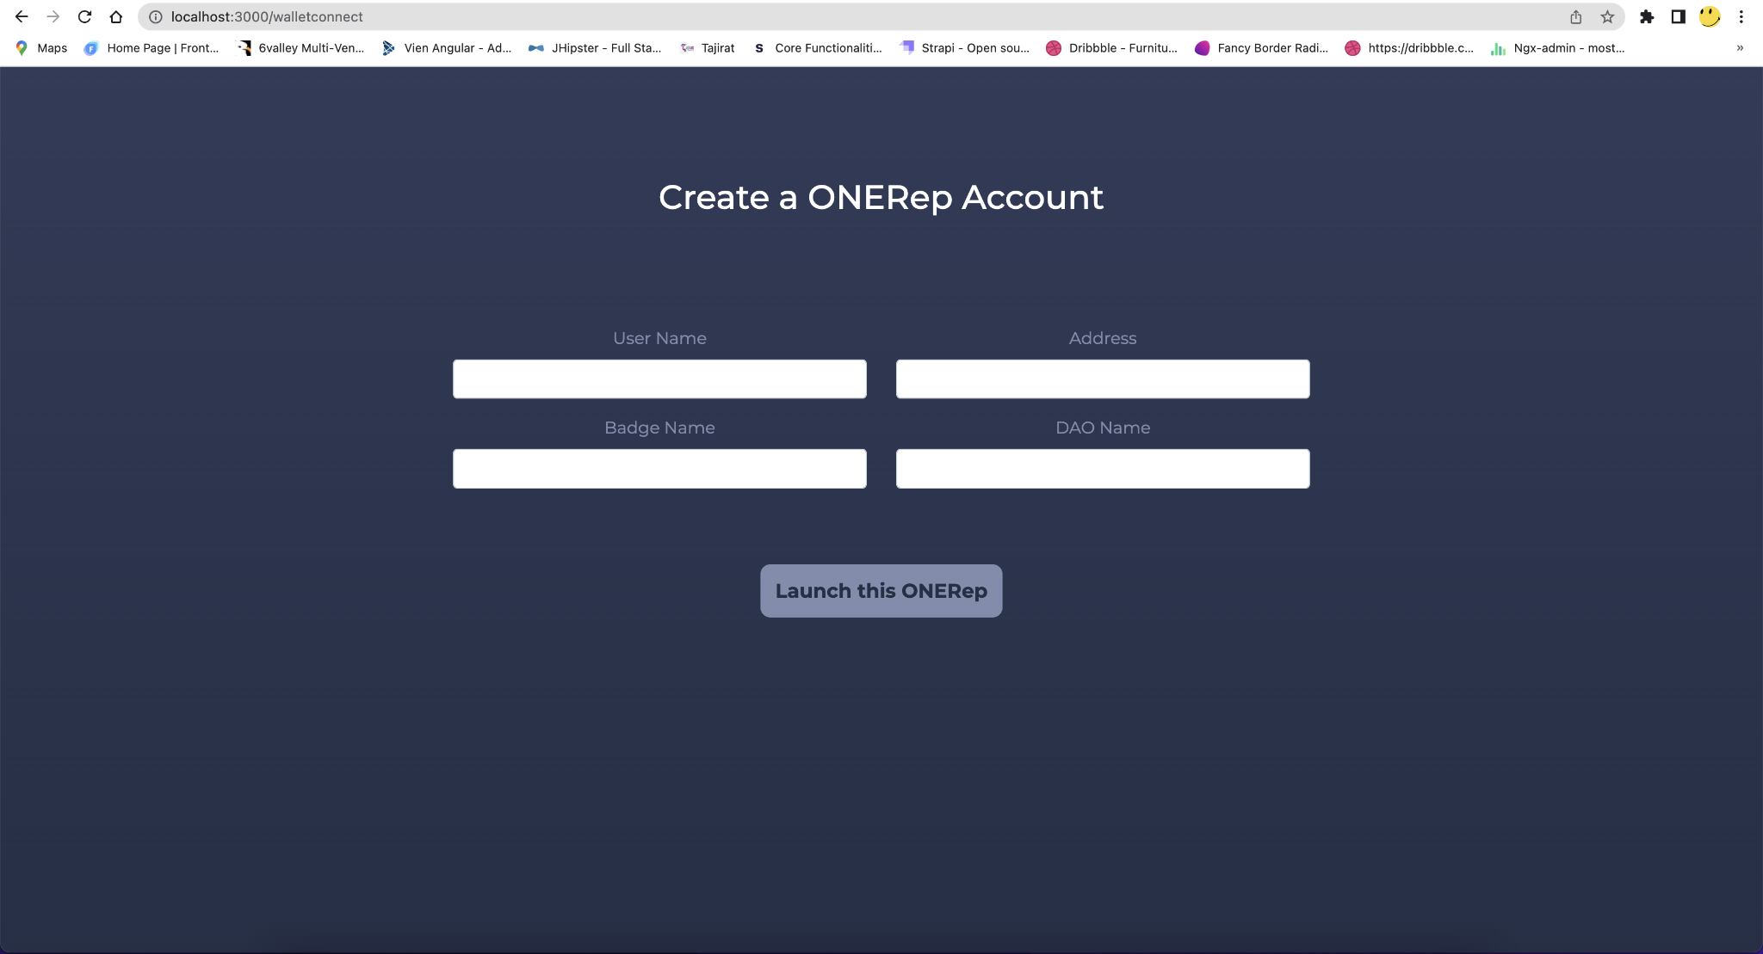
Dapp User - After Wallet Connect

Slide 10
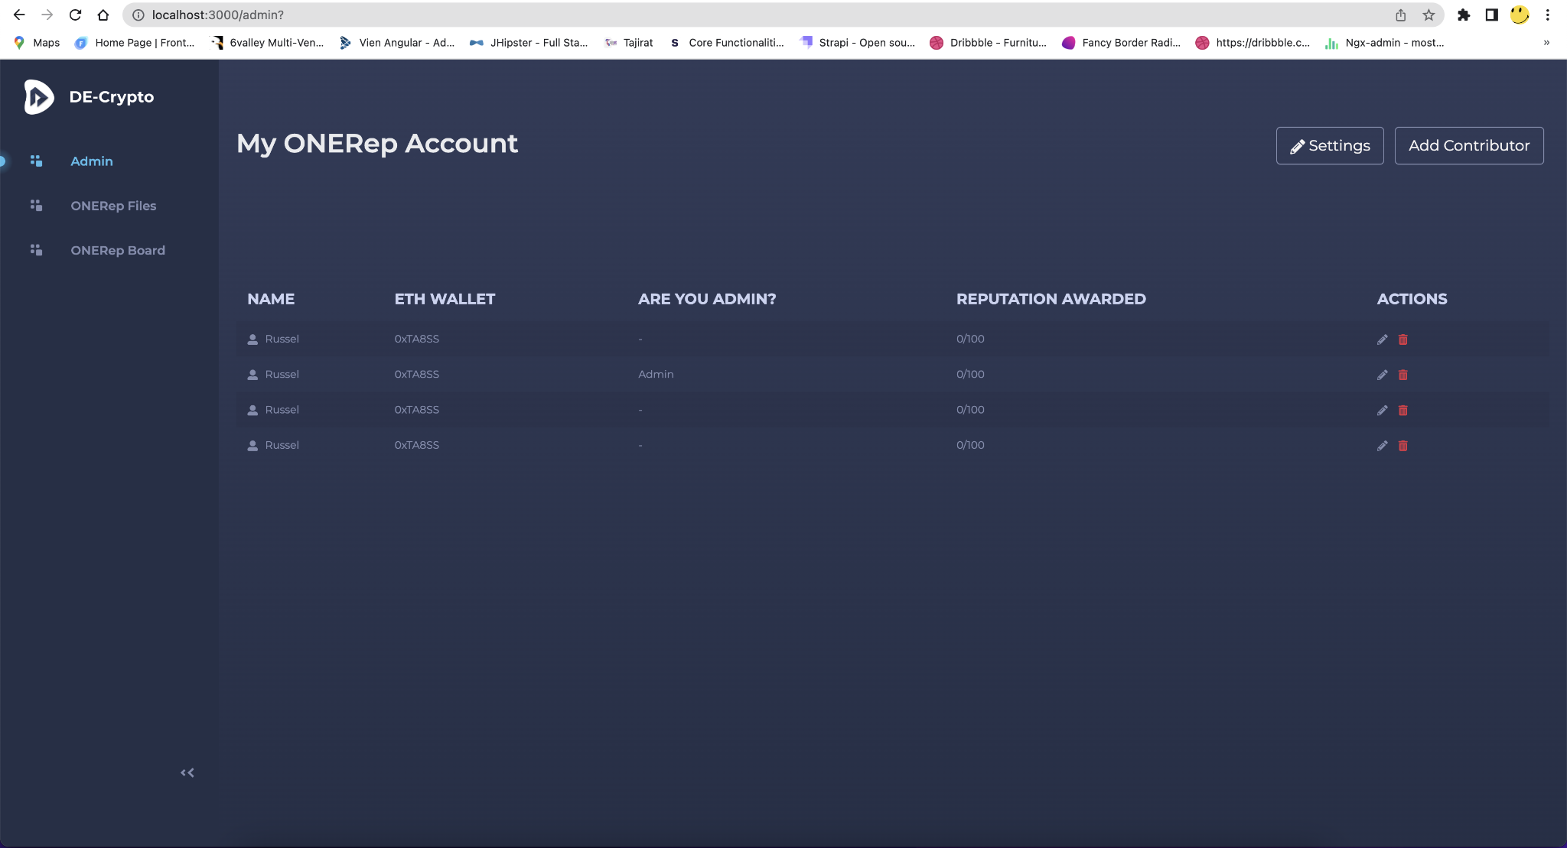
Dapp user - Account Page where user can edit settings and Add Contributor
Below are the list of contributors aded

Slide 11
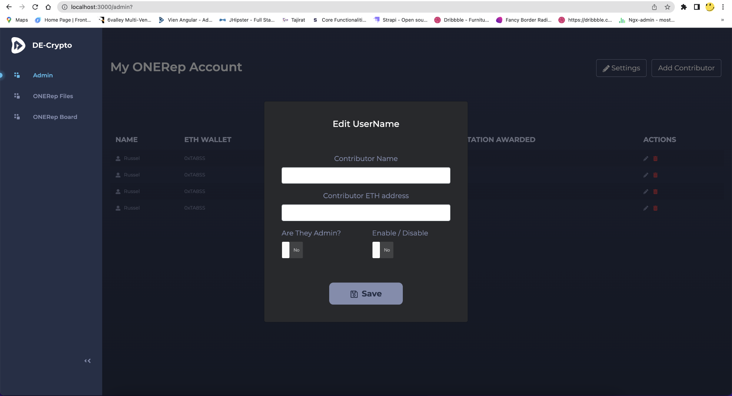
Dapp user - Add/ Edit Contributor

Slide 12
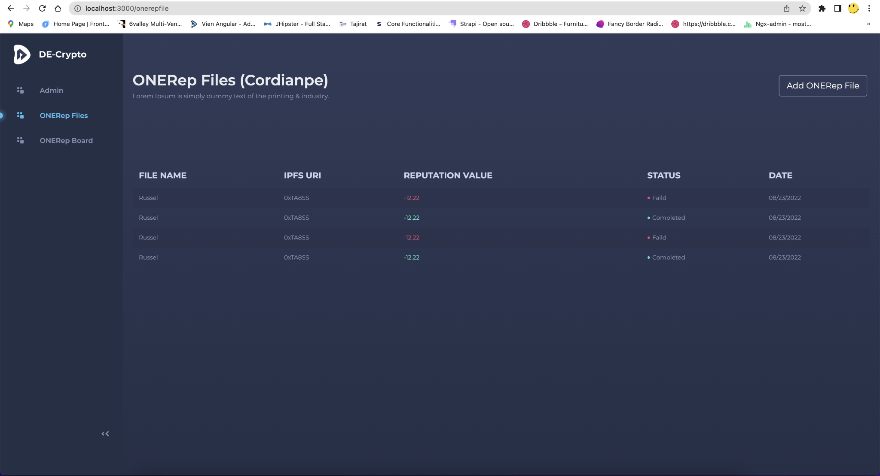
Dapp Users - ONERep Files menu - where we add the csv file and also list the previously uploaded files and mint/allocation status, IPFS URI, Date uploaded etc

Slide 13
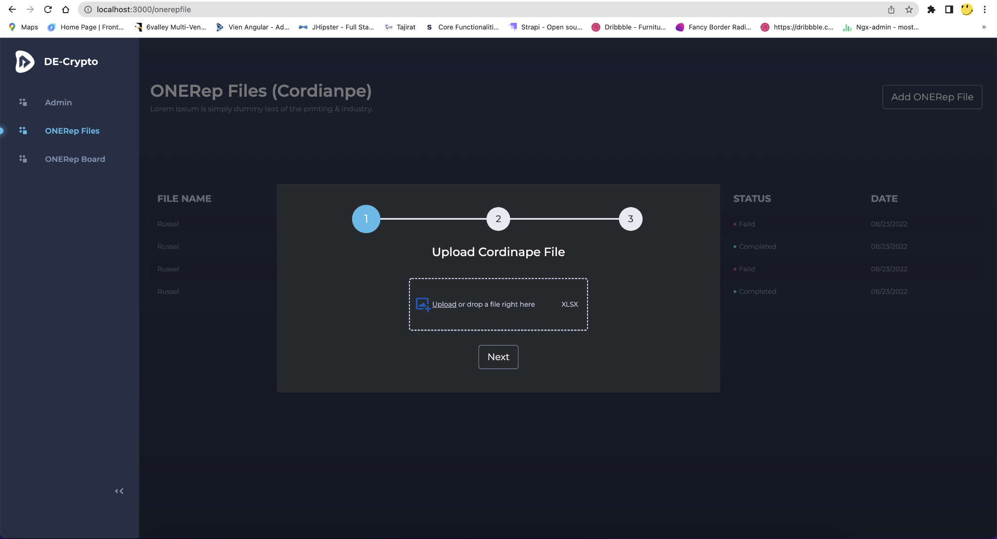
Dapp user : Add ONERep File - Step1

Slide 14
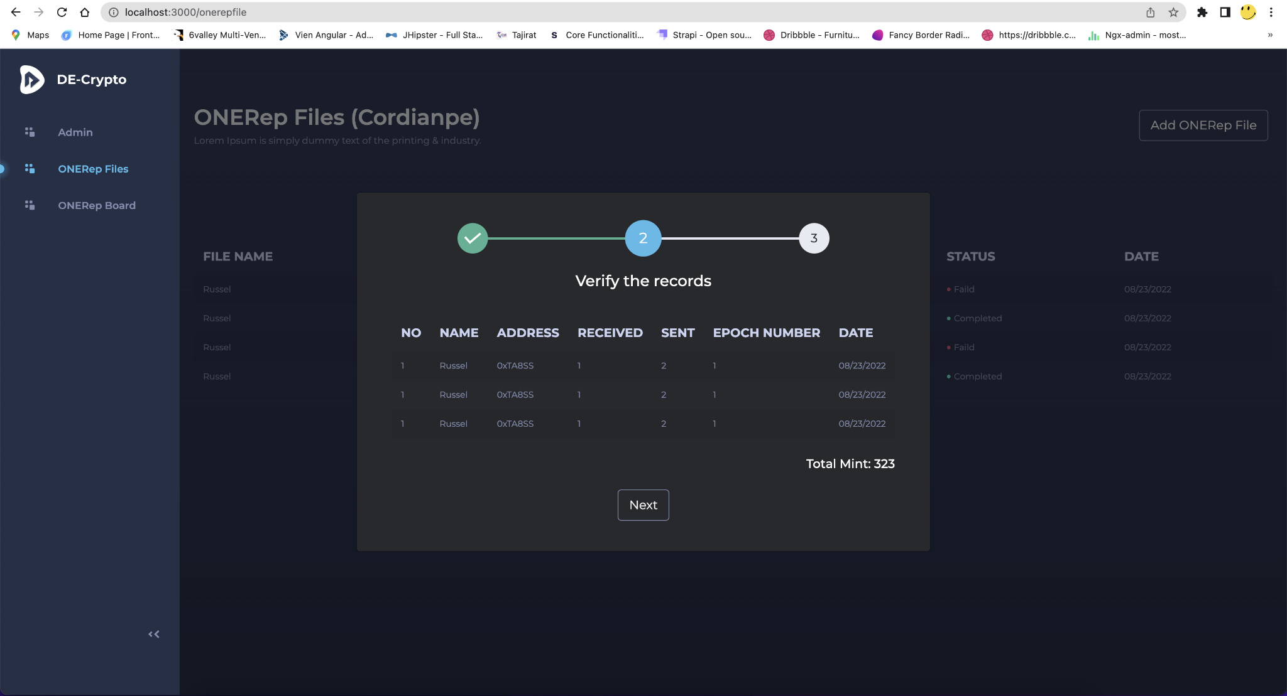
Dapp user : Add ONERep File - Step2

Slide 15
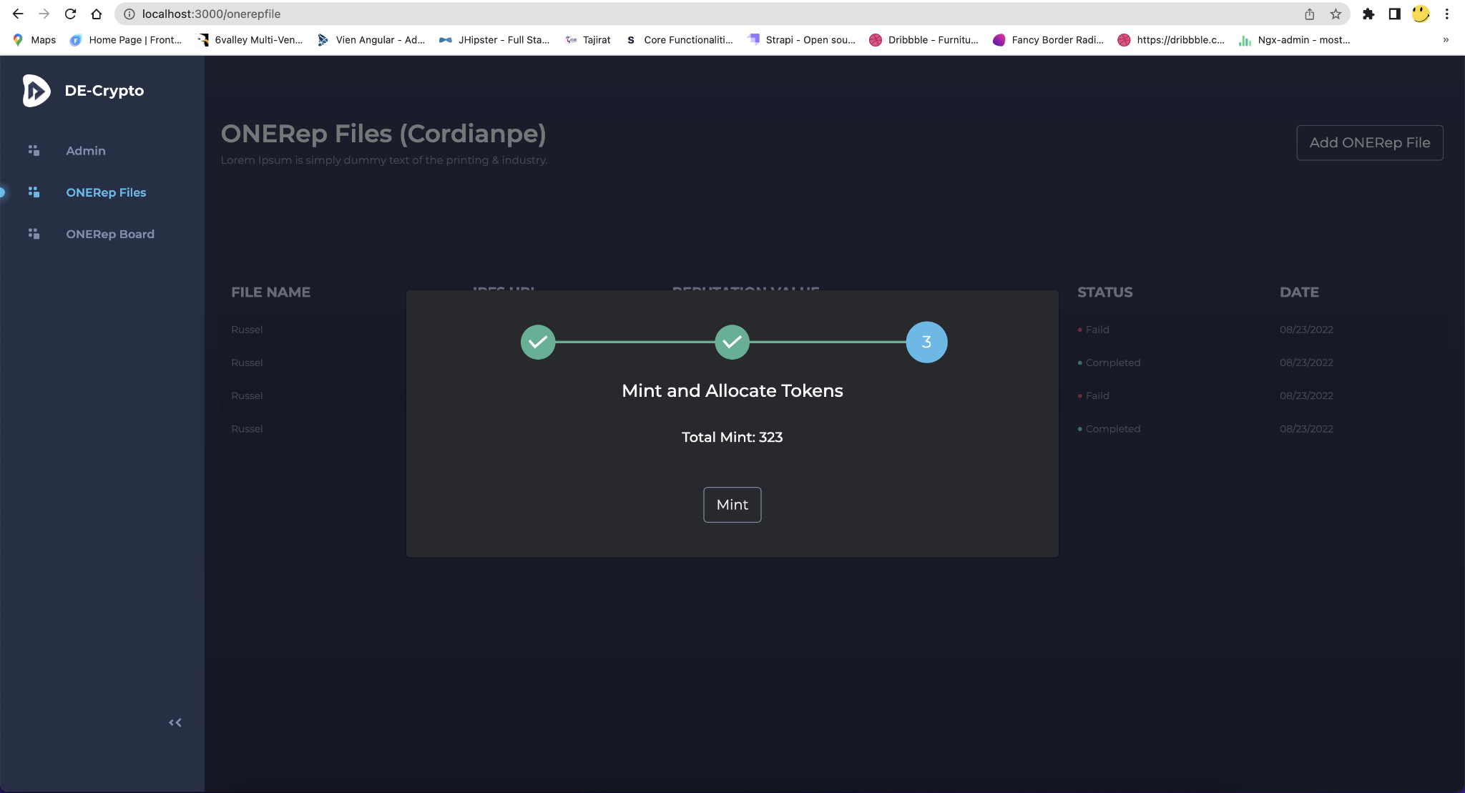
Dapp user : Add ONERep File - Step3

Slide 16
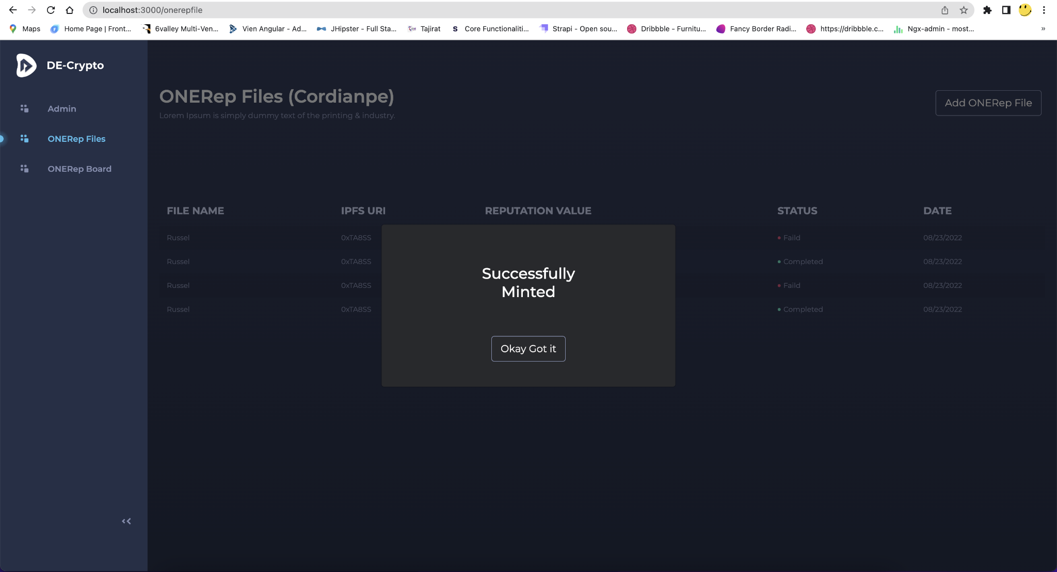
Dapp user : After Mint and NTT allocation to the wallets in the csv

Slide 17
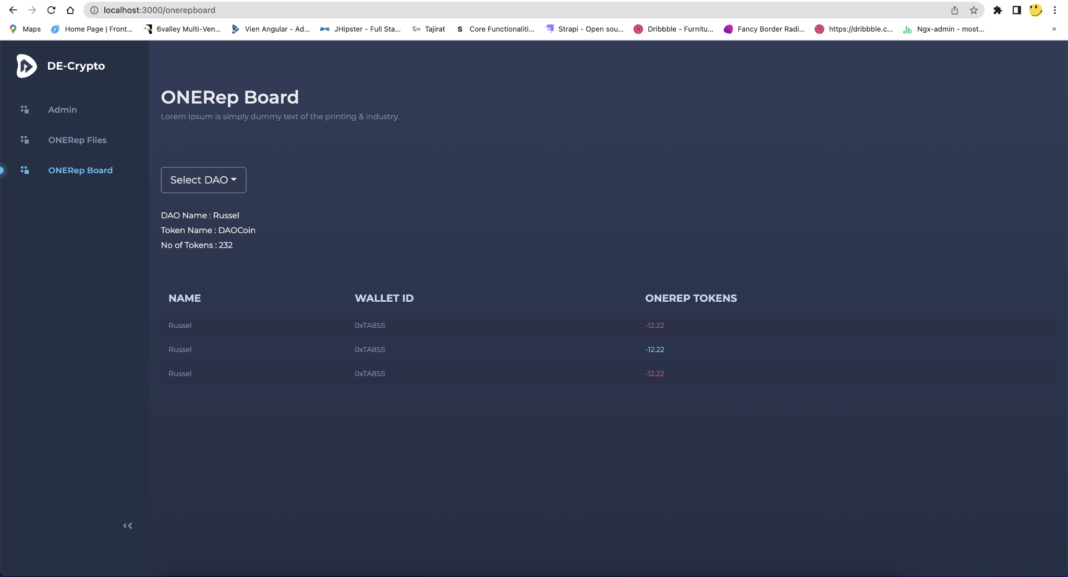
Dapp user : ONERep Board Menu. This is the page where we display all the wallets in the csv, their name and the no of tokens transferred to them. Keep sorting on the table header.

Slide 18
Admin

Slide 19
Admin User - Wallet Connect

Slide 20
Admin User - After Wallet Connect, 1st admin of the Dapp will be hardcoded in the code, the rest will be validated from Contributors list

Slide 21
Admin user - Account Page where Admin can edit settings and Add Contributor
Below are the list of contributors added

Slide 22
Admin user - Add/ Edit Contributor

Slide 23
Admin user : ONERep Board Menu. This is the page where we display all the wallets in the csv, their name and the no of tokens transferred to them. Keep sorting on the table header.
Admin user will be able to see all the wallets from all user accounts and need to have an option to select the account or all

